Slide 1
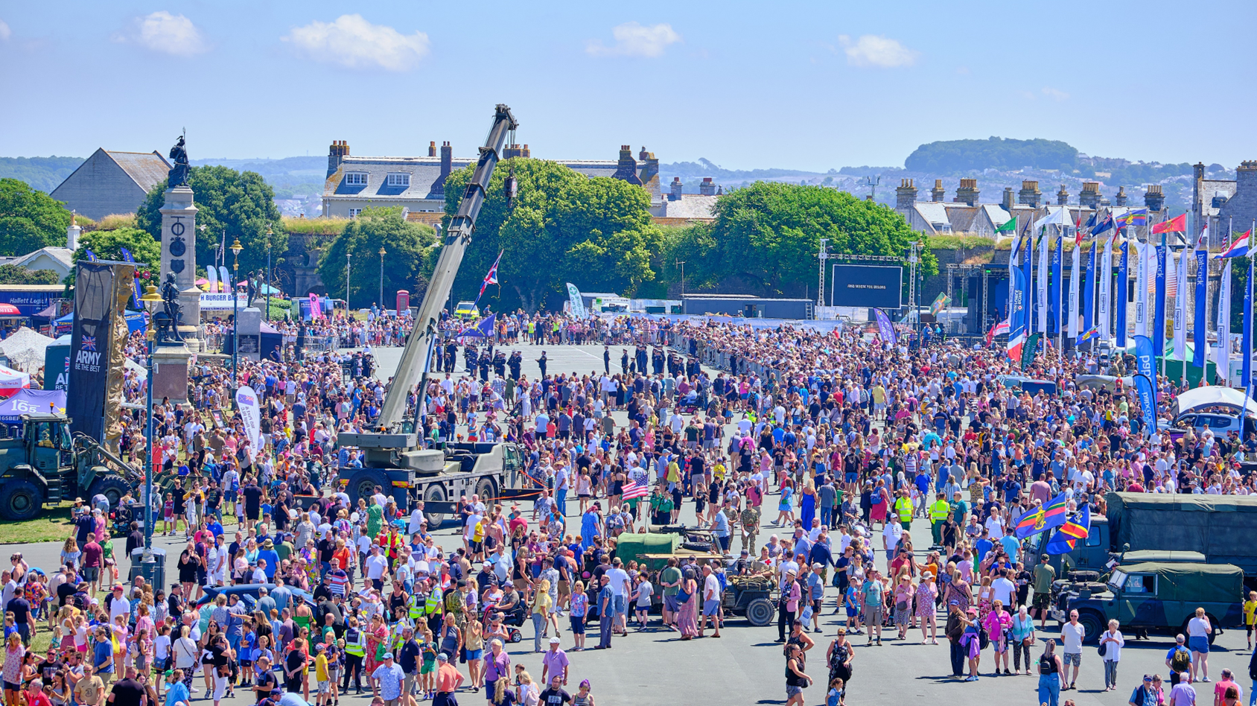
PLYMOUTH ARMED FORCES DAY
SATURDAY 28 JUNE 2025
SPONSORSHIP OPPORTUNITIES

Slide 2
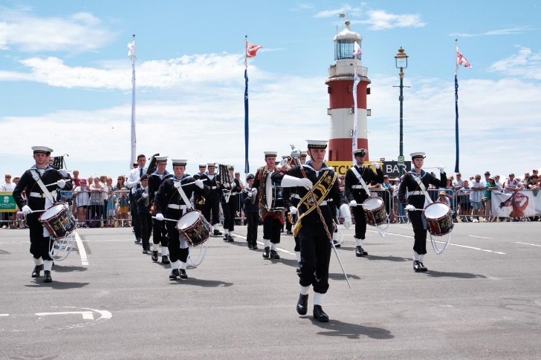
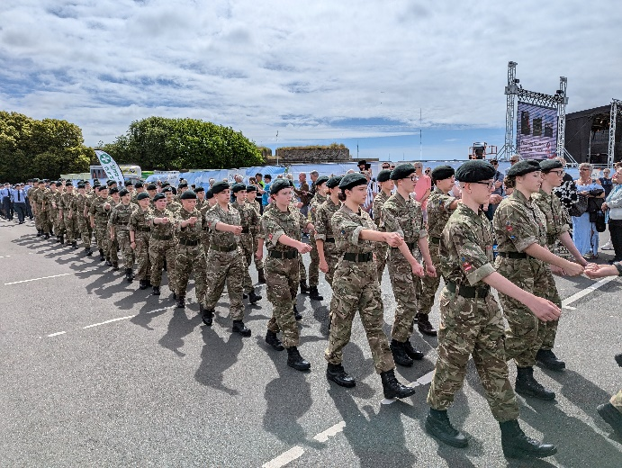
ABOUT PLYMOUTH ARMED FORCES DAY
Each year Plymouth shows its support to the Armed Forces and celebrates their outstanding contribution to the city and UK, by putting on a spectacular free event on Plymouth Hoe, celebrating Armed Forces Day.
Being a Military city, it’s no surprise that this is one of Plymouth’s signature events - which sees between 40K-50K visitors attend throughout the day - making it the perfect event to showcase your business.
The day is packed with free entertainment, thrilling activities and hands-on displays, Military parades and bands, Military equipment, live music, and a stage programme which runs into the evening with a free evening concert.
Visit the website for more information: https://plymoutharmedforcesday.co.uk/
TARGET AUDIENCE
Local community
Veteran groups from across the region
Young people and Veterans looking for training and recruitment opportunities
Military community
Visiting friends and family
Visitors from across the region

Slide 3
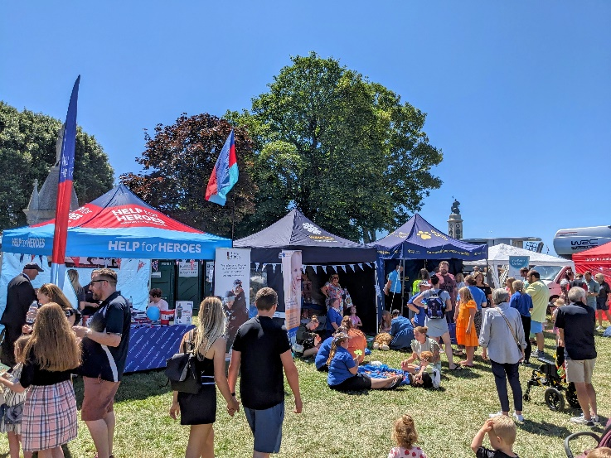
EXHIBITING AND MARKETING OPPORTUNITIES
PREMIUM COMMERCIAL VEHICLE EXHIBITOR:
£2,000 to £3,000
Showcase your products within a large display area, in a prime
high footfall location, for 5 to 10 vehicles plus trailer.
Opportunity to brand your allocated area with flags and banners
Logo and link on plymoutharmedforcesday.co.uk
Logo on the event map, marking your location.
On the day Facebook post with the Armed Forces Flag.
PREMIUM COMMERCIAL PITCH WITH MARKETING BENEFITS: £1,750+VAT
A commercial pitch for a gazebo (3m x 3m) within the Veteran’s
Village, with power (gazebo to be provided by sponsor).
Advertisement on the website: plymoutharmedforcesday.co.uk
Logo and link on the sponsor’s page: plymoutharmedforcesday.co.uk
Digital slide to be displayed on the big screen for three days,
during the Rehabilitation Triathlon and Armed Forces Day.
Opportunity to display a vinyl banner on the main arena at
Armed Forces Day.
On the day Facebook post with the Armed Forces Flag.
Invitation for two guests to attend the sponsor’s cream
tea reception at Elliot Terrace with the Lord Mayor.

Slide 4
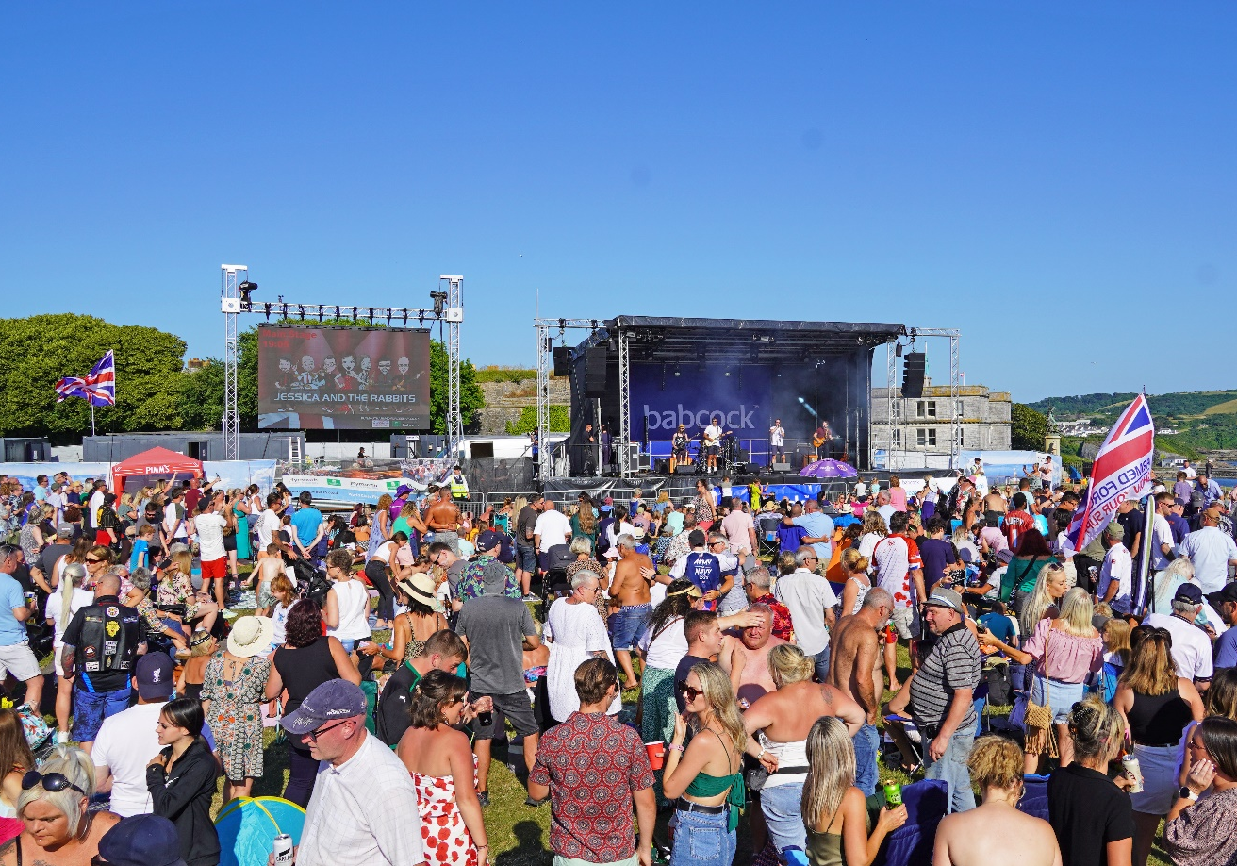
ADVERTISING OPPORTUNITIES
LED BIG SCREEN ADVERTISING:
FROM £300 TO £700+VAT
Promote your business to over 100k people, at Plymouth's signature events on Plymouth Hoe!
Advertise on the LED big screen during the Rehabilitation Triathlon, Armed Forces Day and the British Firework Championships:
Static side - £550+VAT (saving of £50)
Video (max. 30s) - £700+VAT (saving of £100)
Advertise on the LED big screen during the Rehabilitation Triathlon and Armed Forces Day ONLY
Static slide - £300+VAT
Video (max. 30s) video - £400+VAT
Technical spec will be provided. Same video to be used for all three events.
WEBSITE ADVERTISING:
£100+VAT
Digital advertisement on the official website: https://www.plymoutharmedforcesday.co.uk/, with a click through to your website of choice.
Displayed on one of the three most visited web pages - potentially reaching over 20k views.
Spec: 300px width x 300px height (JPG/PNG).

Slide 5
PLYMOUTH ARMED FORCES DAY OVERVIEW
AUDIENCE
45K
ATTENDED 2024
EVENT
REACHED
500K
VIA SOCIAL MEDIA
PAGE VIEWS
100K
VIA WEBSITE
USERS
27.5K
VIA WEBSITE

Slide 6
INTERESTED?
All sponsorship packages can be tailored to best suit your business needs
Please get in touch with Sara Tapp by emailing: afdmedia@plymouth.gov.uk
For details on charity or commercial pitches, email: afd@plymouth.gov.uk
Thank you for supporting our Armed Forces.
plymoutharmedforcesday.co.uk

